Slide 1



FAITH, FAMILY AND BELONGING : FINDING ACCEPTANCE AS AN LGBTQ+ CHRISTIAN
Naomi Bell
GSWS 189: Sexuality in World Religion

Slide 2


✨AGENDA✨
My Background🌸
Why this Matters + Research Insights
UR Survey Insights
Takeaway Message

Slide 3


BACKGROUND
“Faith and family shaped who I am, but also brought challenges.”
• Mom’s Side:
• A mix of devout believers, casual Christians, and those simply praising the Lord.
• First confided in my grandma (Gma), who was supportive and nonjudgmental.

Slide 4


BACKGROUND
• Dad’s Side:
• Church was central—weekly services and Bible study with my grandma.
• Knew i wouldn’t be able to share personal details after witnessing judgment toward LGBTQ+ family members.

Slide 5
Why this Matters
🌈 “Reconnecting with faith felt like coming home.”
• Stopped attending church regularly at 12, but returned in late high school with Gma.
• Scripture and Bible apps became tools for grounding myself during tough times.
• Inspired to help LGBTQ+ youth embrace faith and battle internal conflict they may be feeling from lack of acceptance.

Slide 6
How Churches’ Acceptance Affects LGBTQ Christians
• Affirming church communities serve as essential support systems by fostering a sense of belonging and psychological well-being (Hugues and Rouse, 524).
• Positive messages in affirming churches decrease internalized homonegativity and help alleviate conflicts between sexual/gender identity and religious beliefs (Hugues and Rouse, 524).
• LGBTQ and straight Christians alike report higher feelings of acceptance in affirming church environments (Hugues and Rouse, 530).

Slide 7
How Non-Affirming Churches Impact LGBTQ Christians
• Non-affirming environments often lead to greater internal struggles, including increased internalized homophobia (Meanley, Pingel, and Bauermeister, 37).
• Some individuals in non-affirming contexts rely heavily on spirituality as a source of strength, using it to maintain purpose and self-esteem despite rejection (Meanley, Pingel, and Bauermeister, 40).

Slide 8

Steps Churches Take to Be More Affirming
• Use of LGBTQ-inclusive icons, such as rainbow flags, which signal belonging and acceptance (Hugues and Rouse, 526).
• Accessibility for individuals with disabilities, along with intentional landscaping and welcoming imagery, further enhance feelings of safety and inclusion (Hugues and Rouse, 526).
• Promoting spirituality and social service outreach helps affirm sexual and gender identities, improving mental health outcomes (Meanley, Pingel, and Bauermeister, 38).

Slide 9
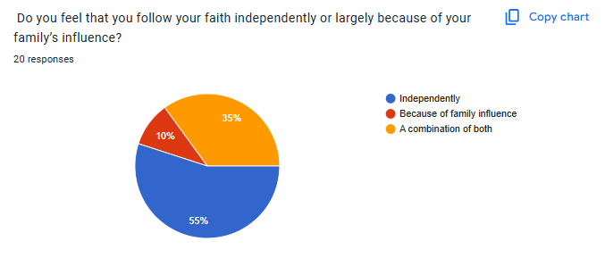
Bringing Awareness to adolescents following independently.

Slide 10
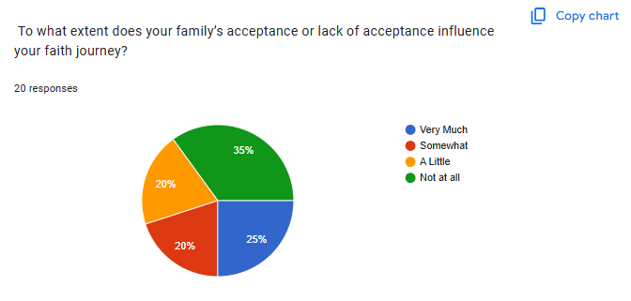
Family may play an important role in faith following but thats not always the case. People follow with friends, partners or alone.
xt

Slide 11
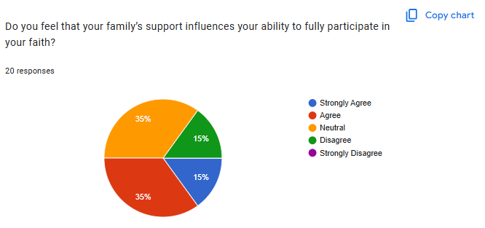
Examining how much family support matters to these students.

Slide 12
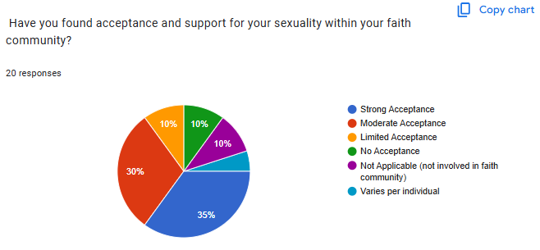
Examining the amount of acceptance in faith communities

Slide 13
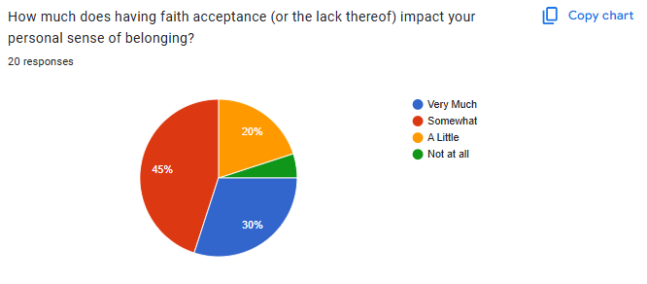
Sense of Belonging from Faith communities

Slide 14
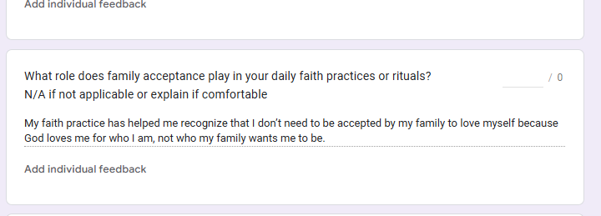
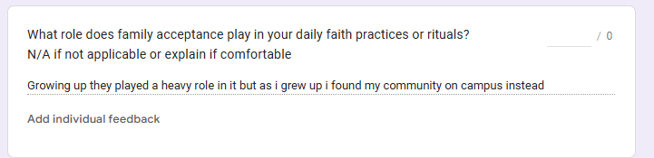
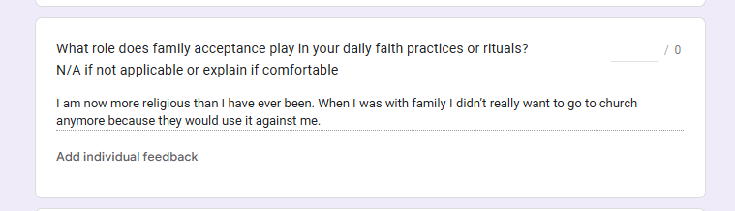

Slide 15
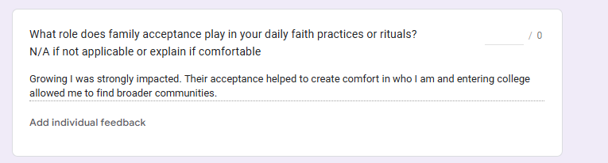
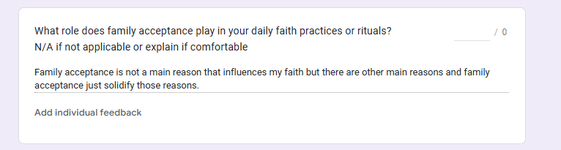

Slide 16
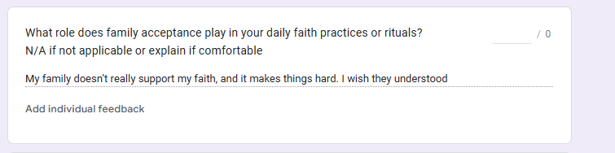

Slide 17

TAKEAWAY MESSAGE
Spreading awareness about following Christianity outside of family acceptance is crucial for LGBTQ youth struggling with internal conflict. Family often plays a central role in our lives, but when acceptance isn’t found there, affirming churches can provide a sense of belonging, support, and spiritual guidance. No one should feel they must give up their faith or identity due to rejection, and creating space for these conversations can help youth find peace, community, and resilience.

Slide 18
Work Cited
Hugues, J. C., & Rouse, S. V. (2023). Everyone Belongs Here: How Affirming and Non-Affirming Church Messages and Imagery Cause Different Feelings of Acceptance in LGBTQ+ Christians. Journal of Psychology and Theology, 51(4), 523-536. https://doi.org/10.1177/00916471231185811
Higa, D., Hoppe, M. J., Lindhorst, T., Mincer, S., Beadnell, B., Morrison, D. M., Wells, E. A., Todd, A., & Mountz, S. (2014). Negative and Positive Factors Associated With the Well-Being of Lesbian, Gay, Bisexual, Transgender, Queer, and Questioning (LGBTQ) Youth. Youth & Society, 46(5), 663-687. https://doi.org/10.1177/0044118X12449630
Meanley, S., Pingel, E. S., & Bauermeister, J. A. (2016). Psychological well-being among religious and spiritual-identified young gay and bisexual men. Sexuality Research & Social Policy, 13(1), 35-45. doi:https://doi.org/10.1007/s13178-015-0199-4
Miller, Kathleen K, et al. The Intersection of Family Acceptance and Religion on The ..., Nov. 2020, https://shine.lab.uconn.edu/wp-content/uploads/sites/3321/2021/06/miller_family_acceptance_2020_annals.pdf
THANK YOU

